Slide 1

Joint profiling of chromatin accessibility, DNA methylation and transcription in single cells
Stephen Clark – Reik Lab, Babraham Institute

Slide 2


Background
Bulk analyses mask intercellular differences
vs.

Slide 3
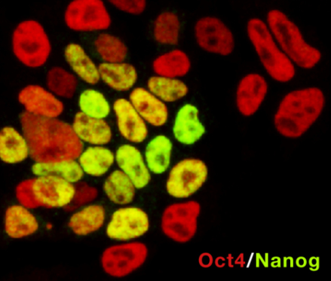
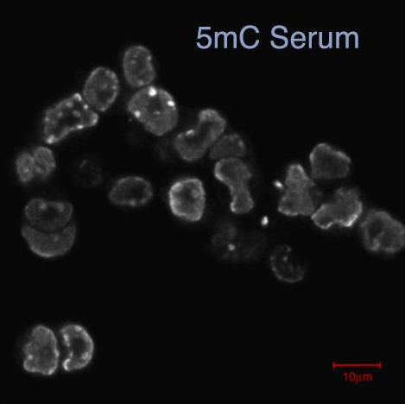
Background
Bulk analyses mask intercellular differences
Silva J, Smith A, Cell, 2008
Fitz et al, Cell Stem Cell, 2013

Slide 4
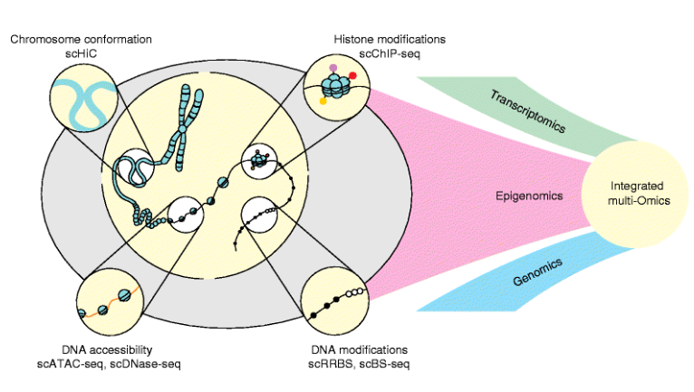
Background
Parallel single-cell methods can be used to infer relationships at individual loci
Image from Clark et al Genome Biology 2016

Slide 5
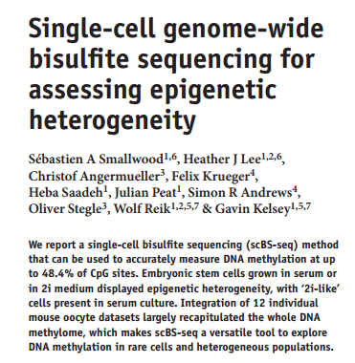
scBS-seq

Slide 6
scBS-seq
Bisulfite conversion:
  Efficiently discriminates 5mC from C
  Fragments DNA – loss of sequences

Slide 7
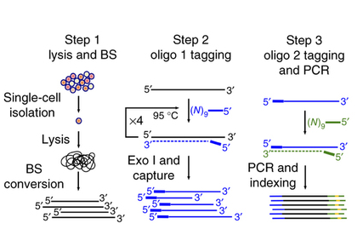
scBS-seq

Slide 8
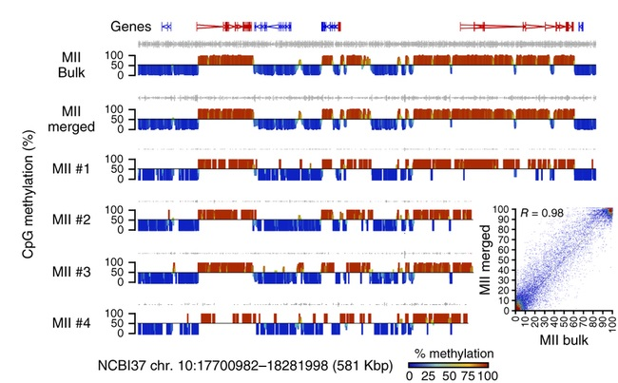
scBS-seq
Typically achieve 20% genome coverage with high concordance to bulk data-sets
Smallwood et al (2014)

Slide 9
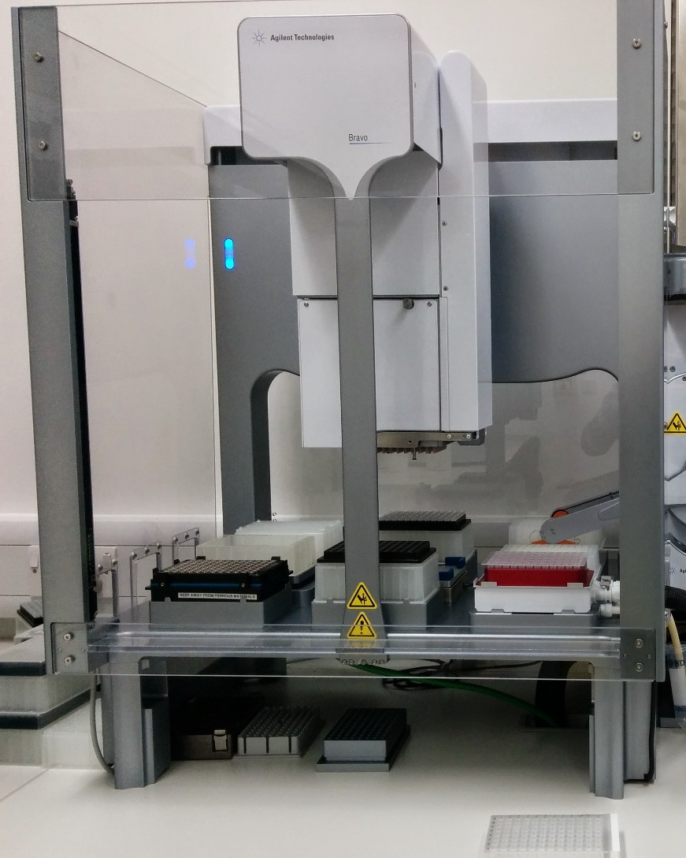
Upgraded scBS-seq
Throughput = 192 cells (vs. 12 previously)
Improved mapping efficiencies (= lower seq costs)

Slide 10
Upgraded scBS-seq
Throughput = 192 cells (vs. 12 previously)
Improved mapping efficiencies (= lower seq costs)
No improvements in coverage

Slide 11
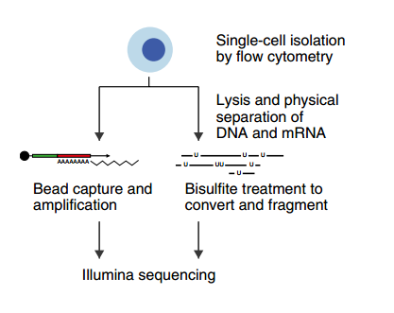
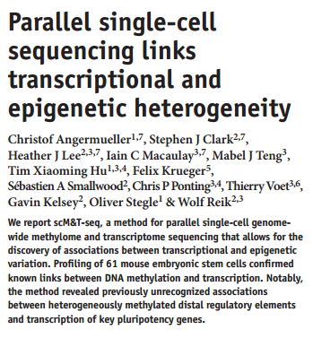
scM&T-seq (+ RNA-seq)

Slide 12
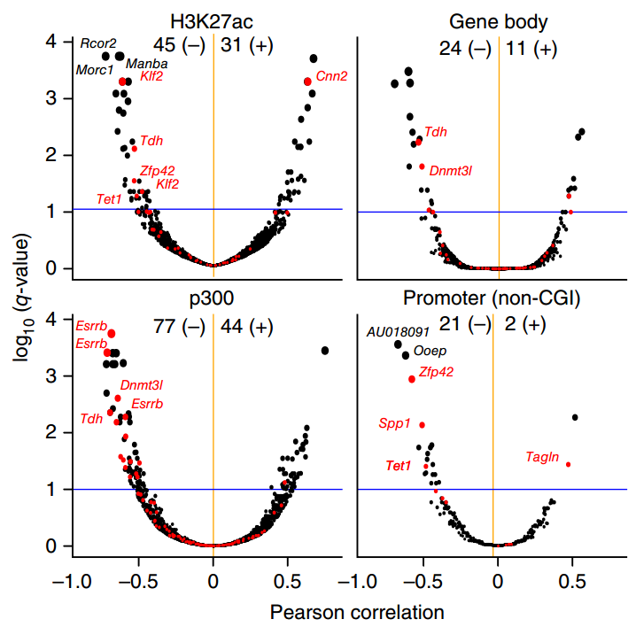
scM&T-seq can discover novel relationships
Analyse relationship between methylation and transcription
Each gene is a data point
  i.e. we see how methylation associates with transcription for every locus in the genome

Slide 13
scNMT-seq: chromatin accessibility

Slide 14
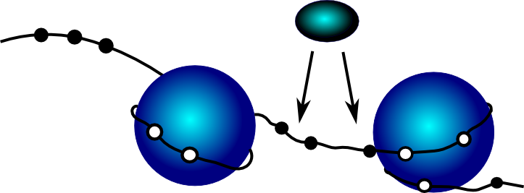
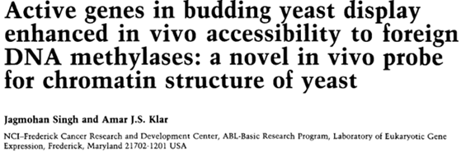
Methylase accessibility
Methylase enzyme labels exposed DNA
  Bisulfite conversion used to discriminate open/closed
Initially used in species lacking endogenous cytosine methylation

Slide 15
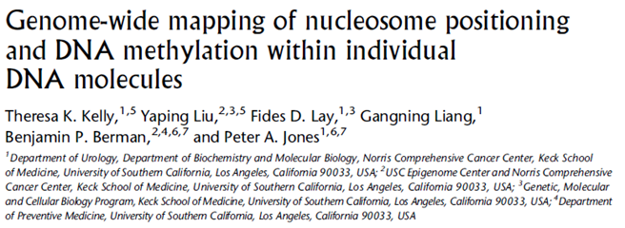
NOMe-seq
M.CviPI (isolated from Cholora virus) methylates GpC
Endogenous GpC methylation <1% in most mammalian cells
Simulatanous read-out of endogenous CpG methylation and accessibility marked with GpC methylation

Slide 16
Methylase vs. fragmentation
Can discriminate between inaccessible chromatin and missing data
Higher maximum resolution:
  GpC every 16bp
    125bp read has on average ~8 independent sites
    3-5M reads mapped per cell (using scBS) = 10’s of millions of data points per cell
Parallel information from the same cell:
  Endogenous CpG methylation
  Compatible with G&T-seq to capture RNA

Slide 17
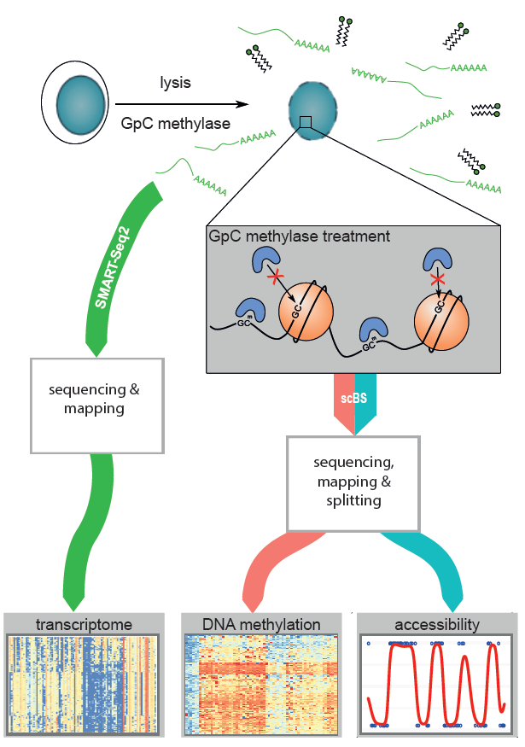
scNMT-seq
+ chromatin accessibility
    GpC methylase to mark open chromatin
    BS-seq to discriminate open from closed
    CpG methylation data also recovered
    RNA-seq by separation of DNA/RNA

Slide 18
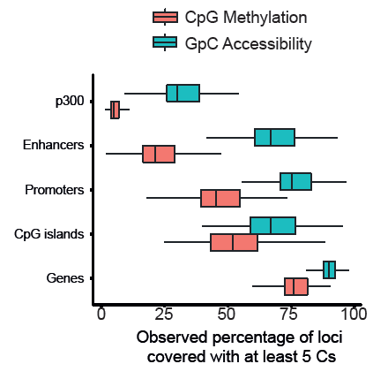
Genome-wide coverage
Number of sites covered per single cell (60 mES cells)
Methylation data is equivalent to previous data (except very small sites)
Accessibility data much improved over published methods (e.g. scATAC-seq = 10% promoters)

Slide 19
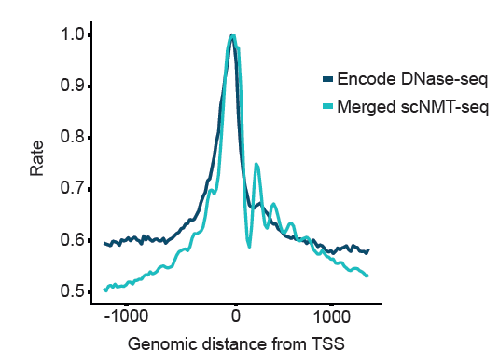
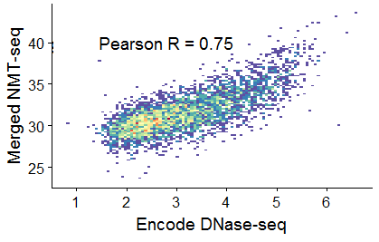
Correlation to published DNase-seq
Merged scNMT-seq correlates with DNase-seq at random 10kb windows
Merged scNMT-seq shows similar enrichment at promoters

Slide 20
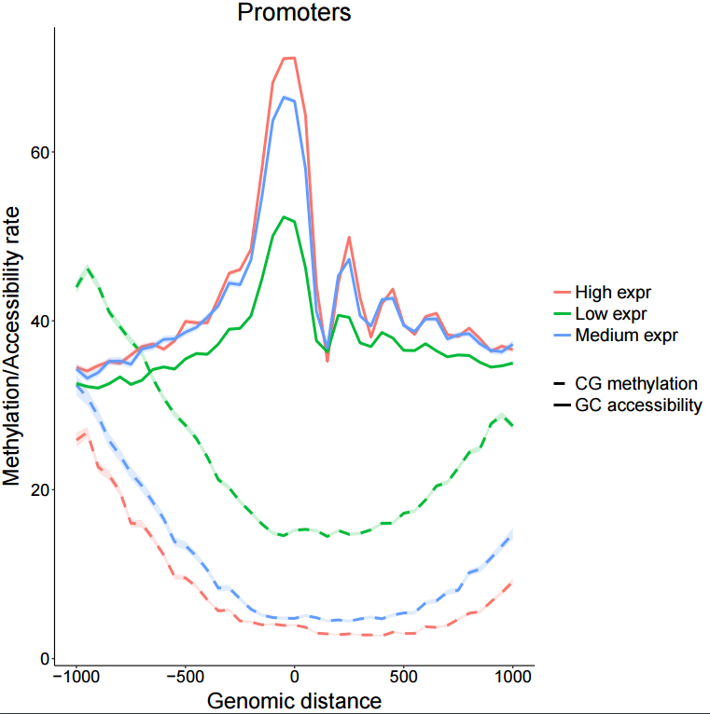
Accessibility increases with gene expression

Slide 21
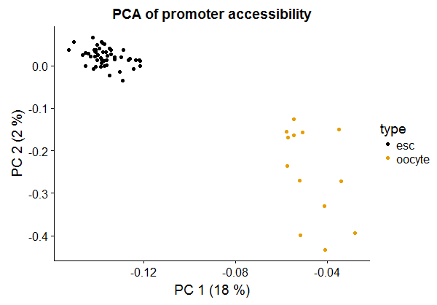
Method can discriminate cell type

Slide 22
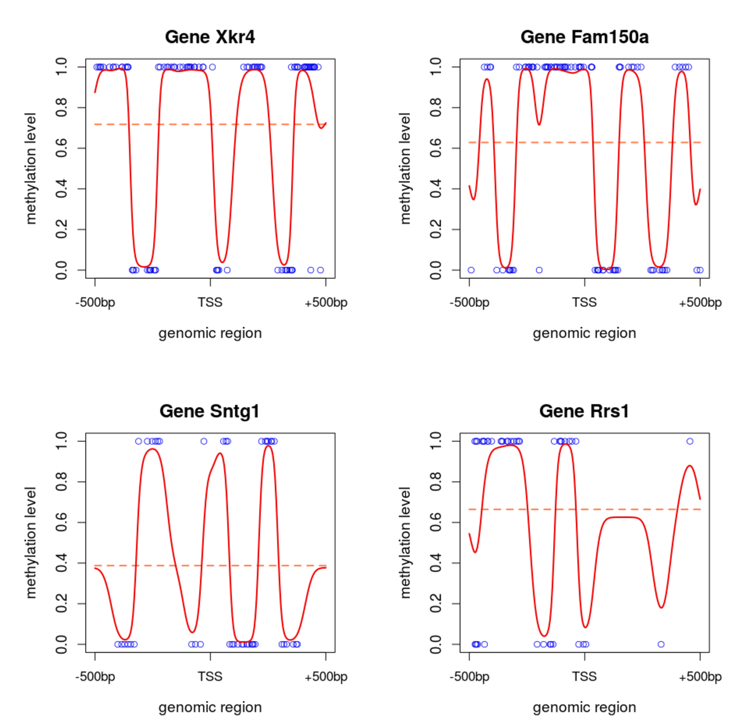
Nucleosome positions
Binomial Probit Regression likelihood to model methylation profiles
Accessibility data shows periodic pattern indicative of nucleosome positions (not present in CpG methylation data)
Andreas Kapourani

Slide 23
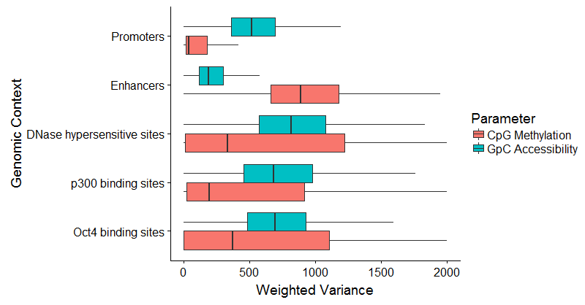
Cell – cell variance
Methylation variance is highest at enhancers
Accessibility variance is highest at known TF binding sites

Slide 24
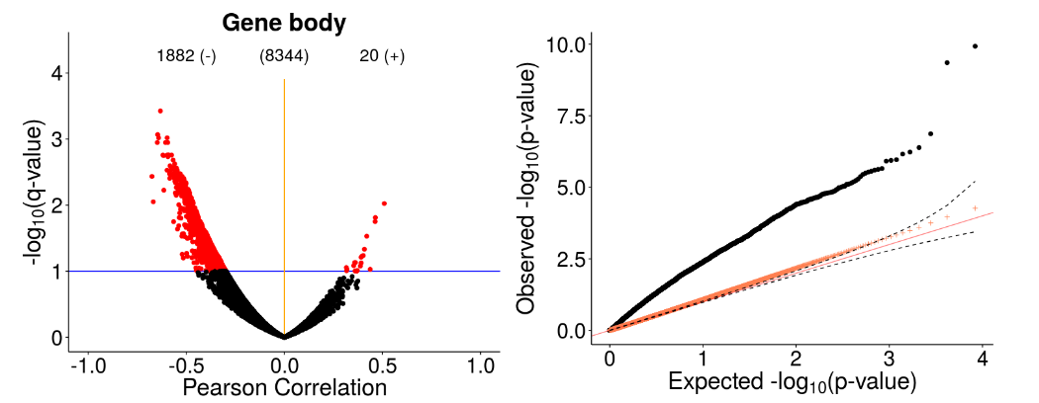
Methylation – accessibility correlations
p-values against Pearson R
QQ-plot of p-values

Slide 25
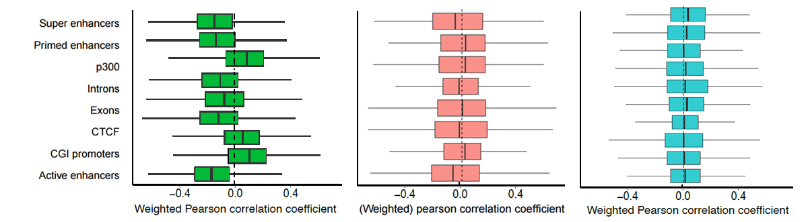
Methylation – accessibility correlations are widespread
Transcription correlations are rarer
Methylation - accessibility
Methylation - transcription
Accessibility - transcription

Slide 26
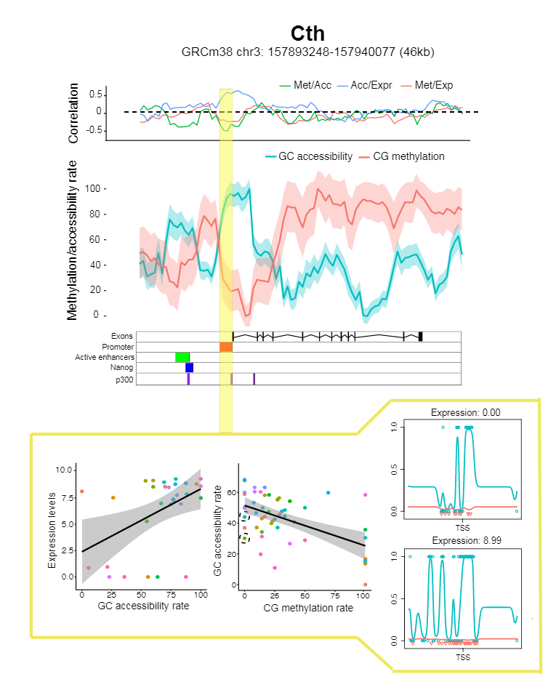
Example locus
Promoter association between accessibility and methylation
Promoter association between accessibility and transcription
Accessibility pattern at promoters varies and is associated with altered transcription
cell 1
low exp
cell 2
high exp

Slide 27
Summary
Combined profiling of chromatin accessibility / methylation / RNA in single-cells is possible
Can be used to discover locus specific associations
Between cell variation is context dependent and differs between methylation and accessibility
Confirmed trend of negative association between methylation and transcription / accessibility (and positive for accessibility – transcription)
Methylation – accessibility more tightly linked than with expression (in this population)
Outlook: study early cell fate decisions in mouse / human development

Slide 28
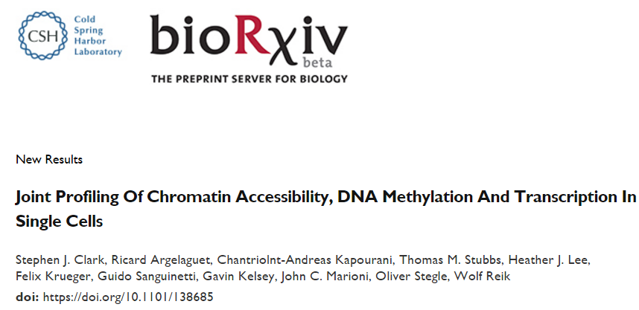

Slide 29




Acknowledgments
Analysis methods
Ricard Argelaguet
Andreas Kapourani
Christof Angermueller
Oliver Stegle
John Marioni
Members of Wolf Reik’s and Gavin Kelsey’s labs
Tom Stubbs
Courtney Hanna
Development of scBS-seq
Heather Lee
Sebastien Smallwood
CG and GC Methylation data processing
Felix Krueger
Development of G&T-seq and scM&T-seq
Iain Macaulay
Mabel Teng
Tim Hu
Thierry Voet
Chris Ponting

