Slide 1
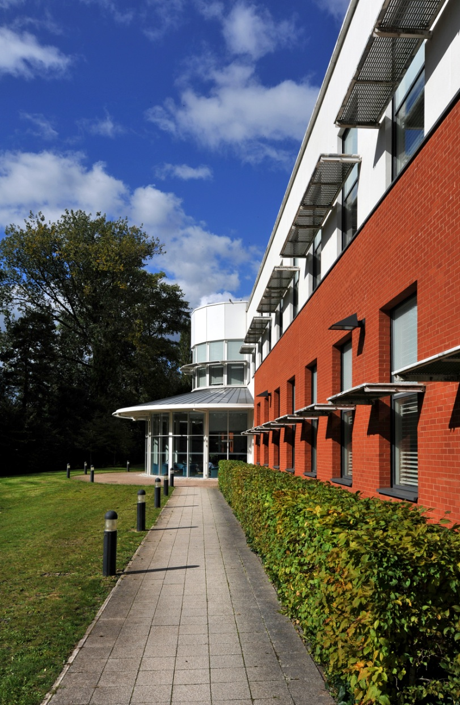



Oxford Consortium for Single-Cell Biology
Symposium, 17 May 2017.
Single-Cell Platform Update
Rory Bowden

Slide 2
Why Single-Cell Analyses?
Describe cell heterogeneity, identity and differentiation
Detect and study individual, rare events
Dissect co-expression circuits
Reconstruct dynamical processes
A Single-Cell Platform might want to facilitate all of the above, while…
Providing access to technology / services
Driving adoption in Oxford

Slide 3
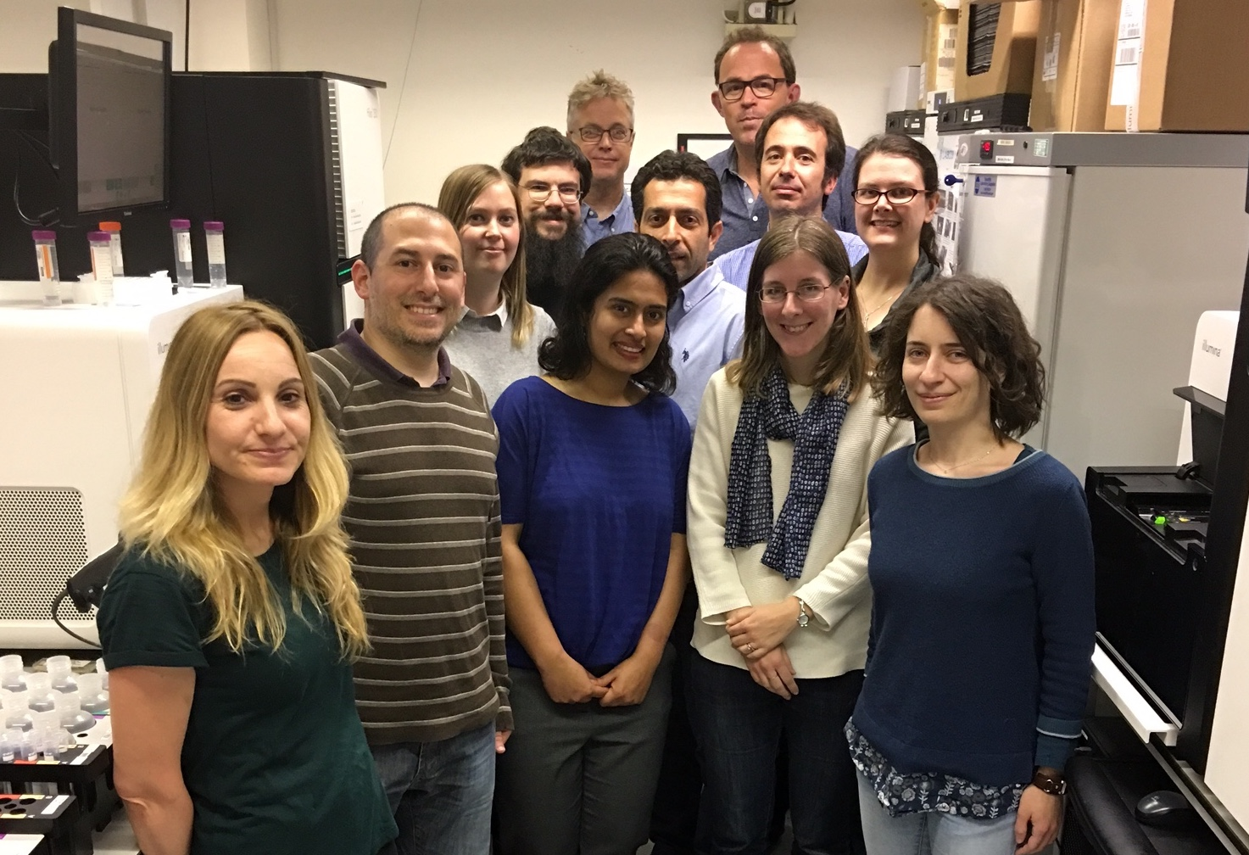
Who are we?
Lab, methods, routine, pipelines, data analysis, management…
+ Quin
+ Fabiola
+ John
+ Angie

Slide 4
How did we get to where we are today?
Early work at the WIMM
Recognition of the need for Oxford to get up to speed in single-cell techniques
MRC CRI award for single-cell infrastructure 2015-6
Finding and buying suitable equipment
Setting up and (self-)training lab and data teams
Service activities
Method and project collaborations

Slide 5
How have we done?
70 SC Projects with Smarter/SS2 ±Nextera
20 C1 RNA Projects
120+ sequencing projects
New methods and platforms
Focus on automation, tracking, robustness
ECHO for miniaturisation
Getting 10X Chromium (SC) up and running

Slide 6
How do we operate?
Core set of routine (service) applications:
  C1-RNA, C1-ATAC-Seq, FACS + SmartSeq2, 10X Chromium SC-RNA
Bleeding-edge (collaborative) methods:
  CellEctor, SeqWell, C1-SMART-ATAC, Capture-Seq, Plate-SC-ATAC-Seq, Cell preservatives, GZ-WGA, …
Grey area in-between:
    Miniaturised methods, 10X VDJ,
‘Limbo’:
  Fluidigm: Polaris, BioMark, C1-HD

Slide 7


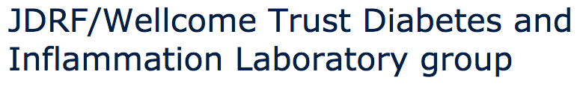



How have things evolved since May 2016?
Substantial volume of projects
Consolidation phase (the end of the beginning)
Confidence in routine offerings
‘Parking’ stalled methods projects
New methods to be supported via collaborations

Slide 8
‘The Grey Area’ of SC Applications
✓ C1-96-SC-RNA-Seq
C1-SC-WGA
C1-SMART-ATAC
C1-ATAC
MMI CellEctor
✓ FACS + Smart-seq2
Plate-SC-ATAC-Seq
Miniaturised
Smart-seq2
SeqWell
✓ 10X SC-RNA
GZ-WGA
10X V(D)J
Plate-SC-WGA
SC-Exome
Cell preservative(s)
SC-Capture-Seq
Polaris
Robust
Repeatable
Routine

Slide 9
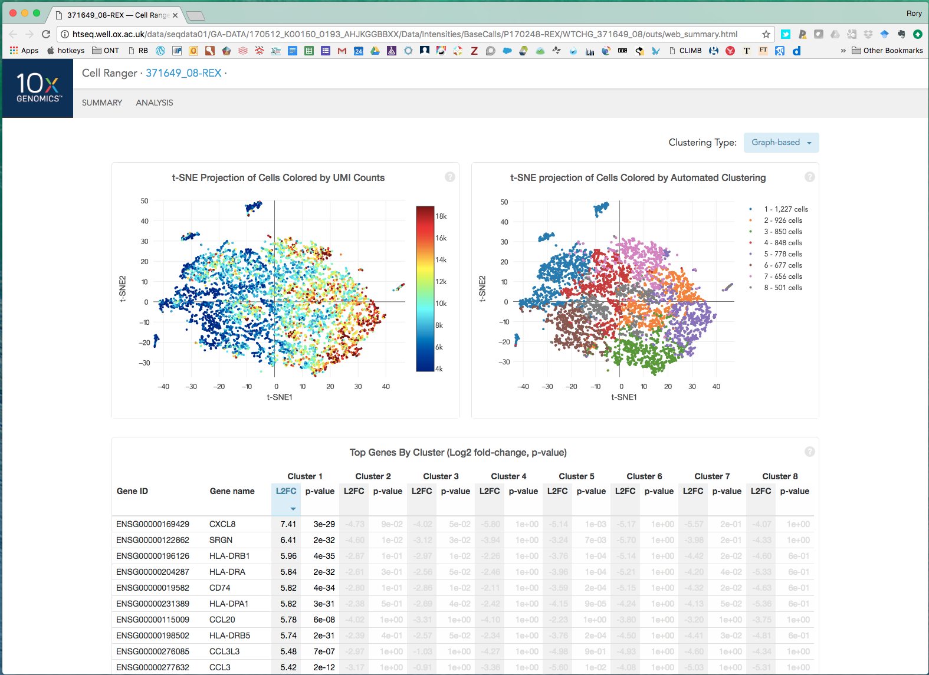
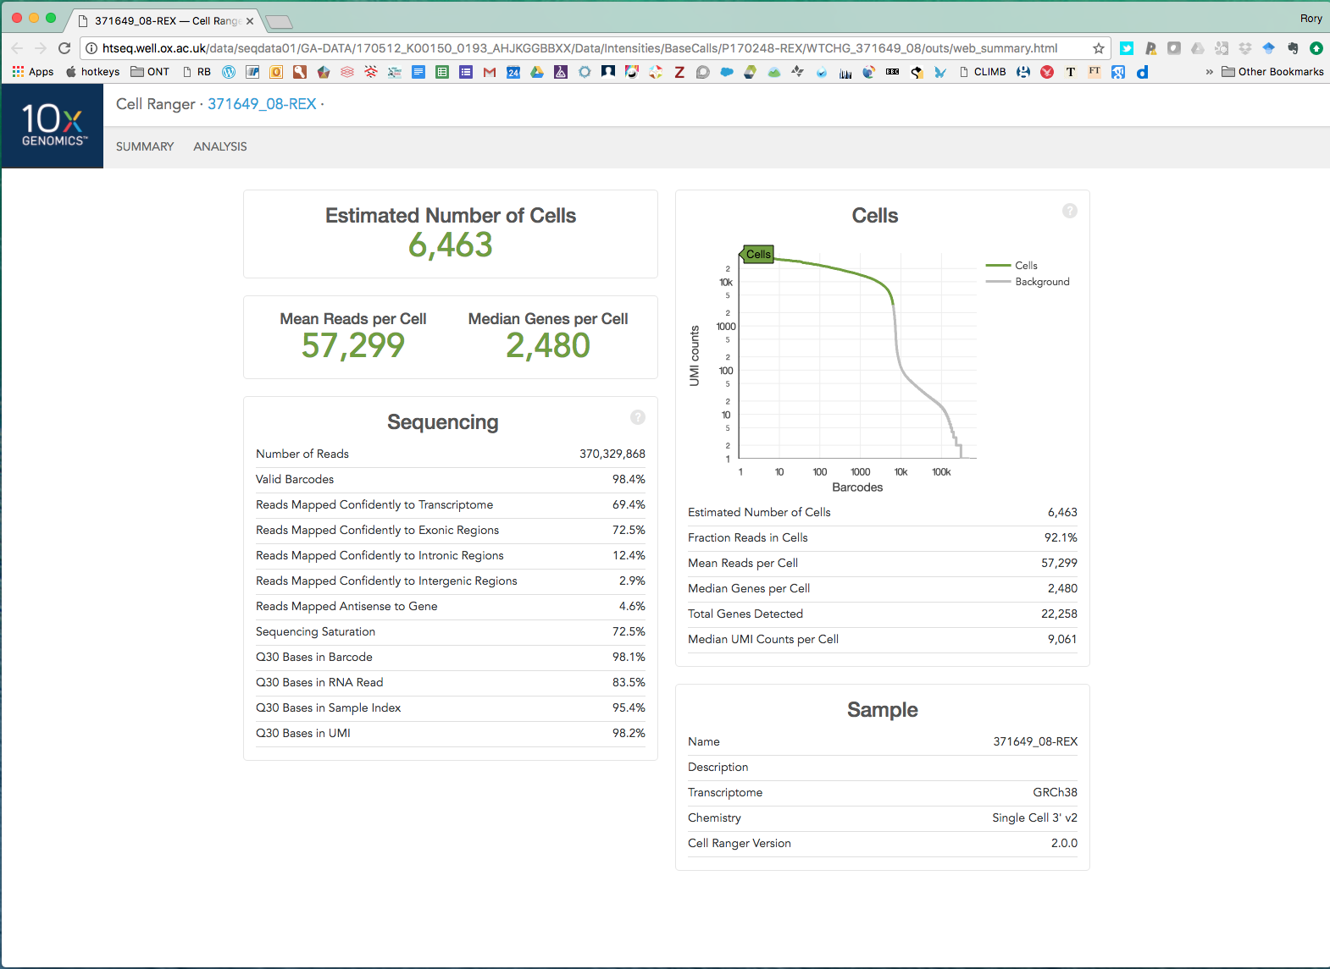
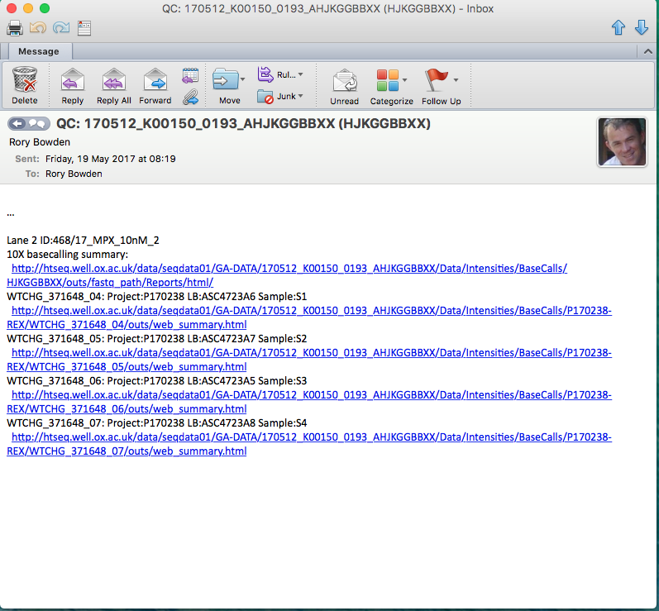
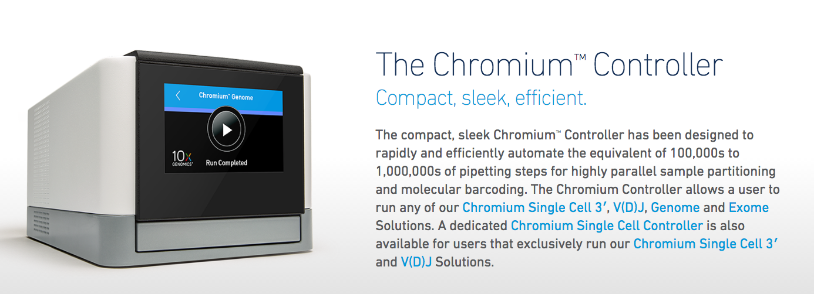
What is 10X (and what is all the fuss)?
10X Chromium System https://www.10xgenomics.com/ …
Oligo(dT) beads plus water-in-oil emulsion
SC-RNA-Seq (3’ end-counting) library application
Synthetic Long Reads Genomics application
SC-V(D)J (TCR, Ig) RNA-Seq application
Robust, easy-to-use, quick, portable
Accessible data exploration and analysis…
Loupe browser: https://support.10xgenomics.com/single-cell-gene-expression
Default platform for many SC studies
Contact WIMM or WTCHG (genomicsinfo@well.ox.ac.uk)

Slide 10
Exploiting the robustness of Smart-seq2
SMARTer family of cDNA protocols devised for low-input bulk RNA-Seq
Smart-seq2 (Picelli) introduced as single-cell cheap, homebrew method
Combines with scaled-down Nextera for full-length RNA-Seq libraries
Automated as 96- or 384-plate
Bulk controls always included in SC experiments
High quality/complexity, favourable cost for large-scale studies
FACS and lyse in 2μL
Scale up lysis vol
Extract RNA and dilute
1
10
100
10³
10⁴
10⁵
cells
1pg
10pg
100pg
1ng
10ng
100ng
1μg
RNA

Slide 11
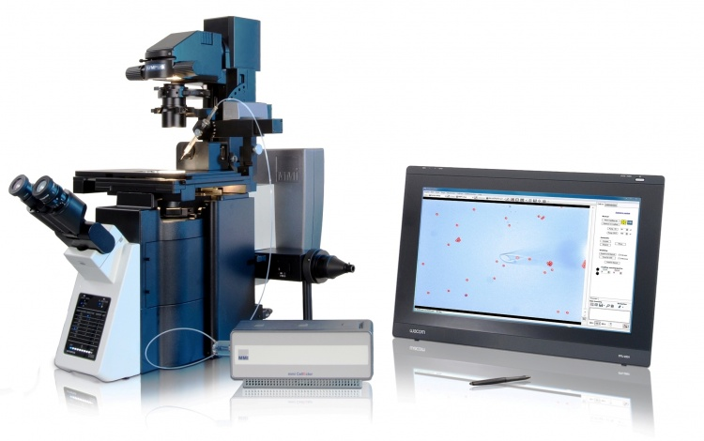
Olympus IX83 / MMI CellEctor

Slide 12
Finally …
Open Calls / Opportunities:
MMI CellEctor / Calcium Imaging
10X V(D)J
10X SC-RNA-Seq
(10X Genomic applications)
SC CaptureSeq
Cell Preservatives

Slide 13
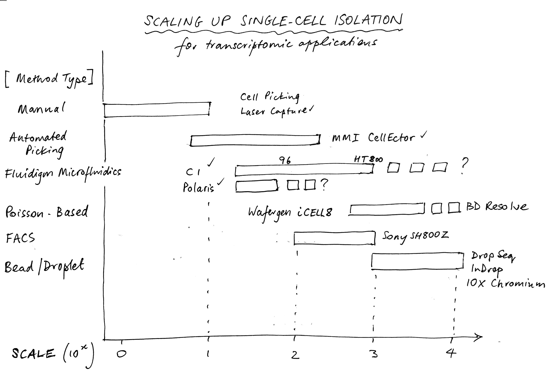
In Summary…

